Slide 1
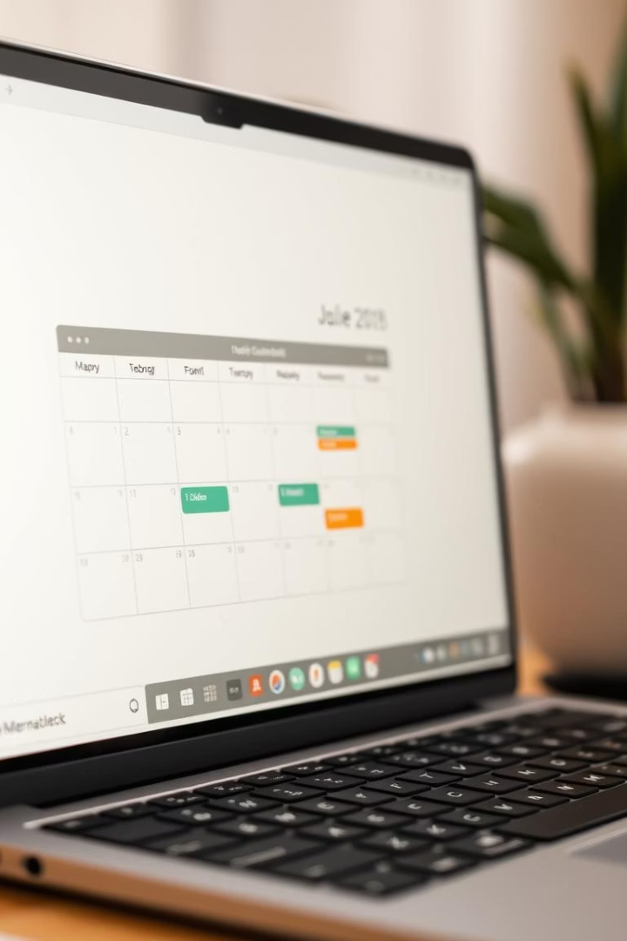
Calendar Management System
Pasang and Prasanna

Slide 2
Introduction: Organizing Your Time
Purpose
Core Functions
Manage events, tasks, and schedules.
View calendars .
Simplify daily organization for users.
To-do list
Handle various events.

Slide 3





System Features
View Calendar
Add Event
View Event
Displays monthly calendar layout.
Allows users to create new events.
Shows details for selected events.
To-Do List
Delete Event
Manages daily tasks and priorities.
Removes unwanted calendar entries.

Slide 4
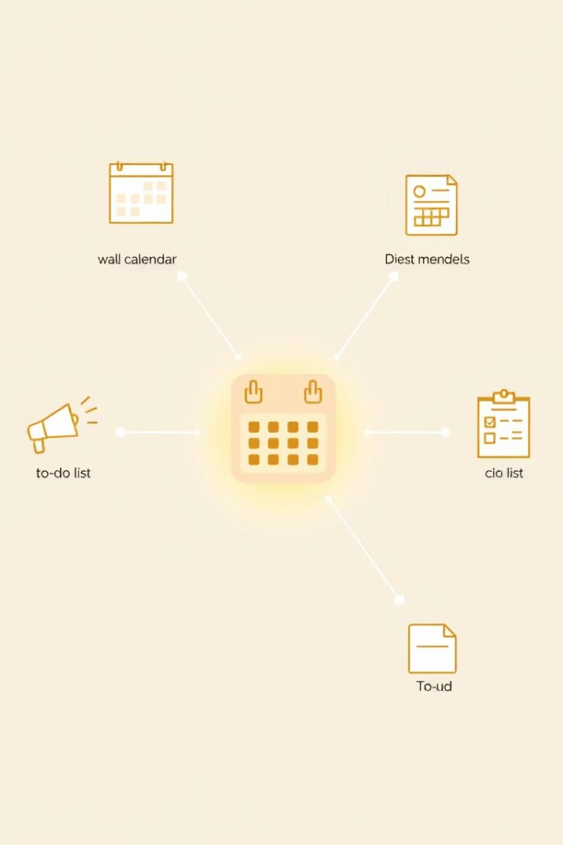



System Architecture: Core Components
Calendar View
Manages calendar display logic.
Receives date inputs.
Event Handling
Adds, views, and deletes events.
Interacts with event data files.
To-Do List
Manages task creation and status.
Handles to-do data storage.

Slide 5









Calendar View Logic: Date Calculations
User Input
Total Days
Accepts desired month and year.
Calculates days in the month.
Print Calendar
Leap Year Check
Displays the formatted calendar.
Adjusts February days if applicable.

Slide 6
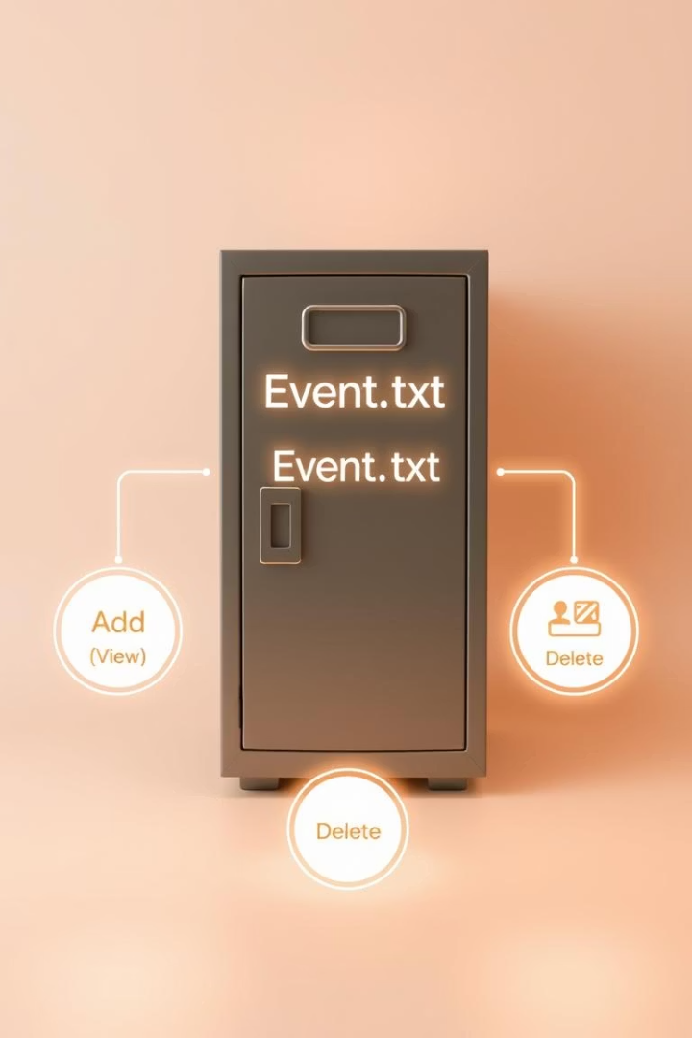
Event Management Logic
Adding Events
New entries saved to
event.txt
.
Includes date, time, and description.
Viewing Events
Reads entries from
event.txt
.
Filters by date for relevant display.
Deleting Events
Removes specific entries from
event.txt
.

Slide 7
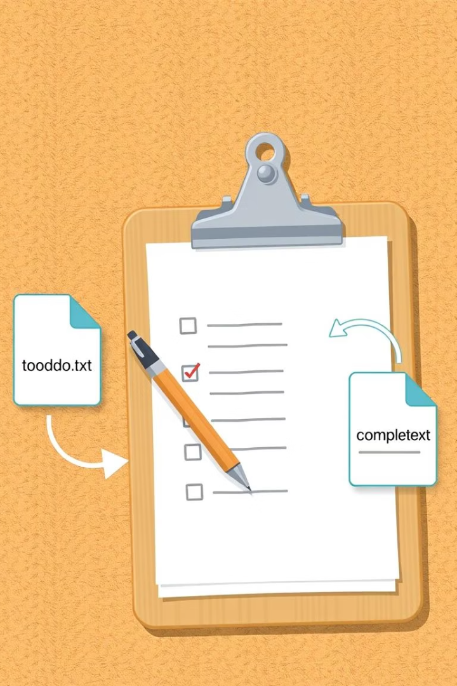
To-Do List: Task Tracking and Storage
Adding Tasks
Viewing Tasks
New tasks appended to
Displays all pending tasks from
todo.txt
todo.txt
.
.
Each task has a unique identifier.
Shows completion status clearly.
Mark as Completed
Moves tasks from
todo.txt
to
complete.txt
.
Reflects task status accurately.

Slide 8

Conclusion: Future Enhancements
1
2
Improvements
Features
GUI implementation for better UX.
Real time notification

Slide 9
Thank You

